Slide 1
Project Overview

Slide 2
Hello !
We are GROUP 16
Github: https://github.com/chalovina/Group16/tree/master/Group16_MppProject
Demo Video: https://www.youtube.com/watch?v=DoL4I_s_dPo

Slide 3
All features are implemented (including extra optional parts)
Login
Checkout
Add copy
Add library member
Add book
Search and print checkout entry record
Search and print overdue checkout

Slide 4
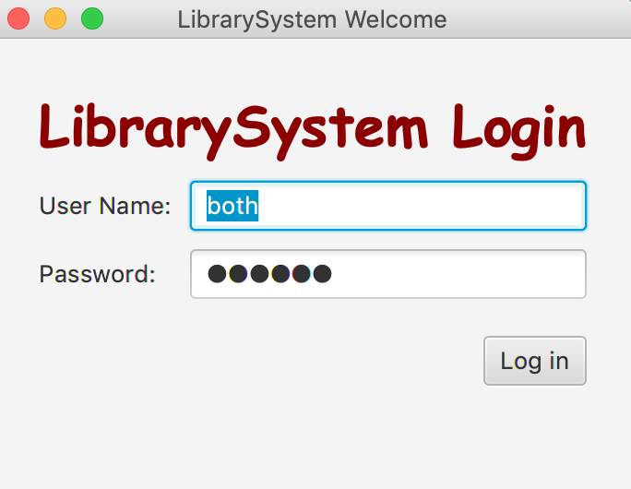
1.LOGIN
Difference roles: Super Admin: both
Admin: admin
Librarian: lib

Slide 5
LOGIN
Use Case Description:
User Action | System Response
1. User enters username and password, then clicks login | 1. System checks validity of login information and presents the Main Window. The main window presents the options which are depended on the authorization level of user returned with 3 level of LIBRARIAN, ADMIN, and BOTH. - LIBRARIAN level includes options: Checkout Book, Print Checkout Record, and Overdue Checkout. - ADMIN level includes options: Add Member, Add Book, and Add Copy. - BOTH level includes the options of both LIBRARIAN and ADMIN.

Slide 6
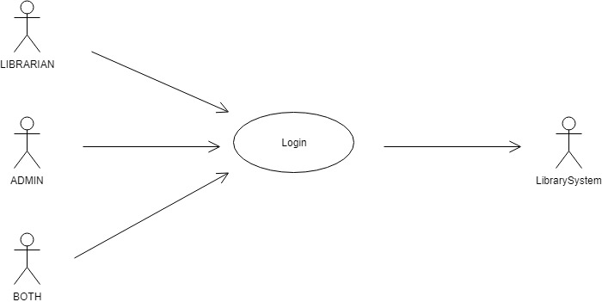
LOGIN
Use Case:

Slide 7
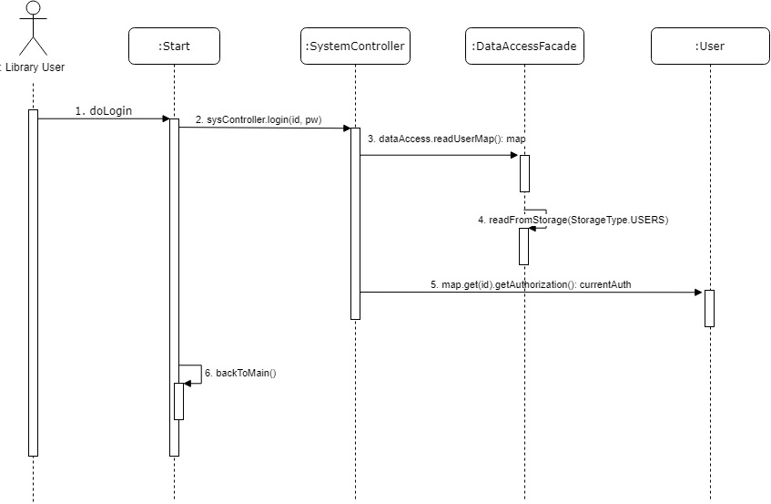
LOGIN
Sequence diagram:

Slide 8
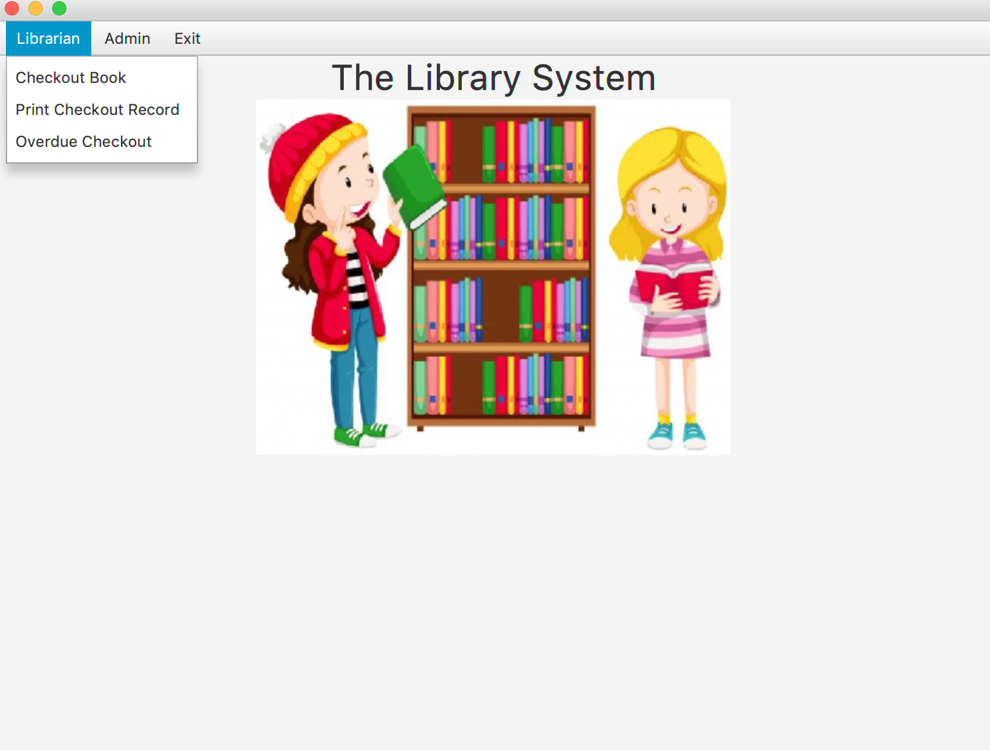
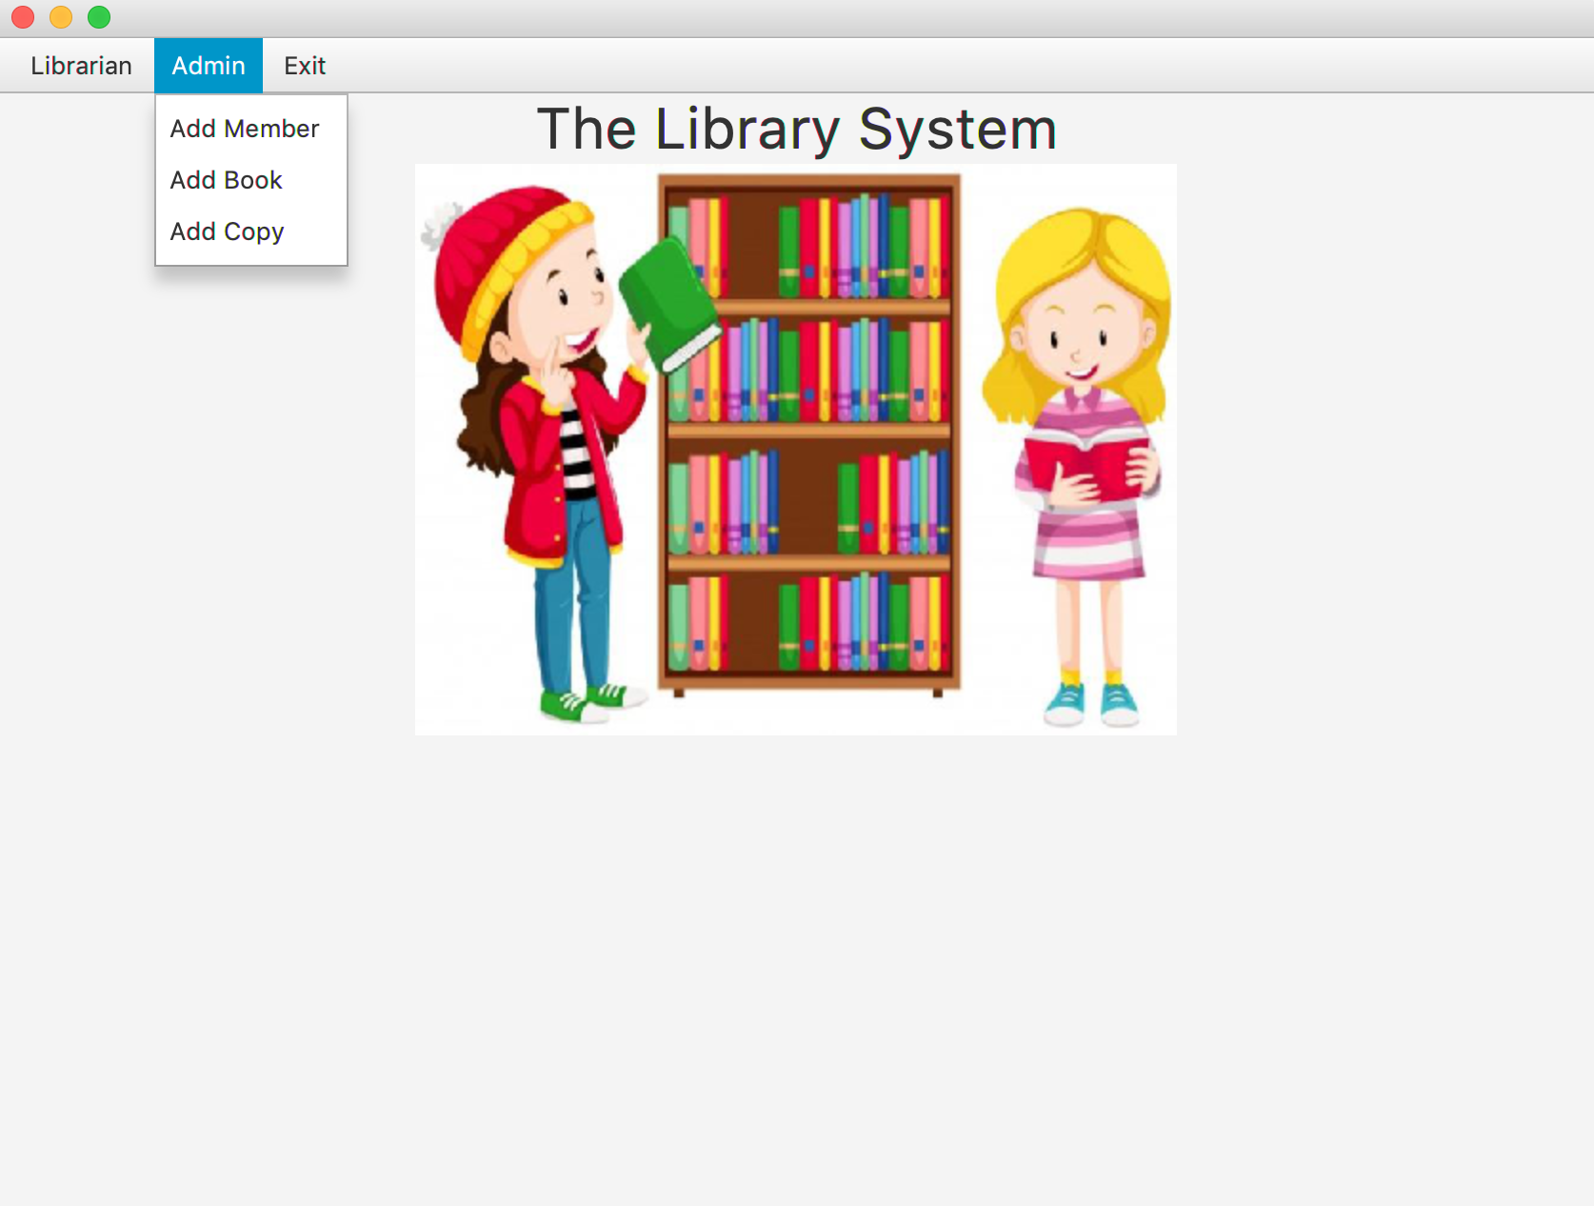
Super admin view
Super admin has fully permission for role: Admin and Librarian

Slide 9
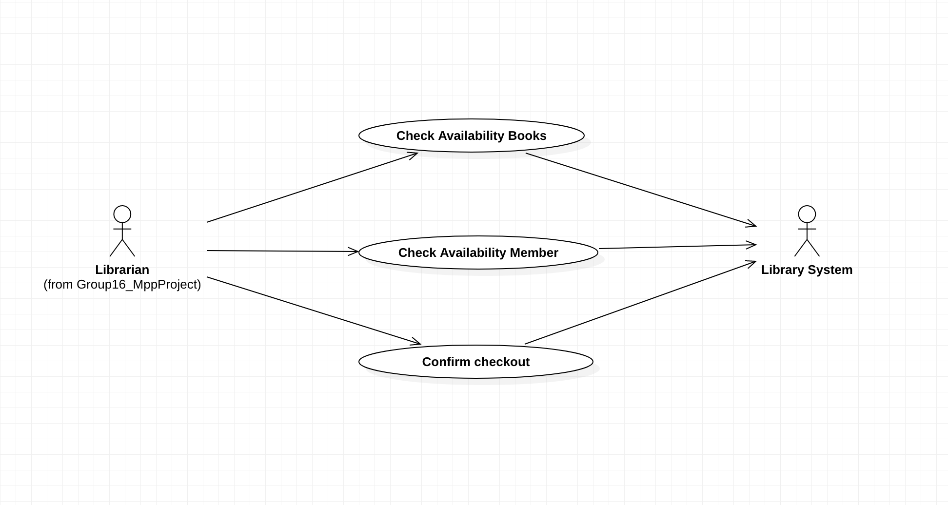
Checkout, Use case

Slide 10
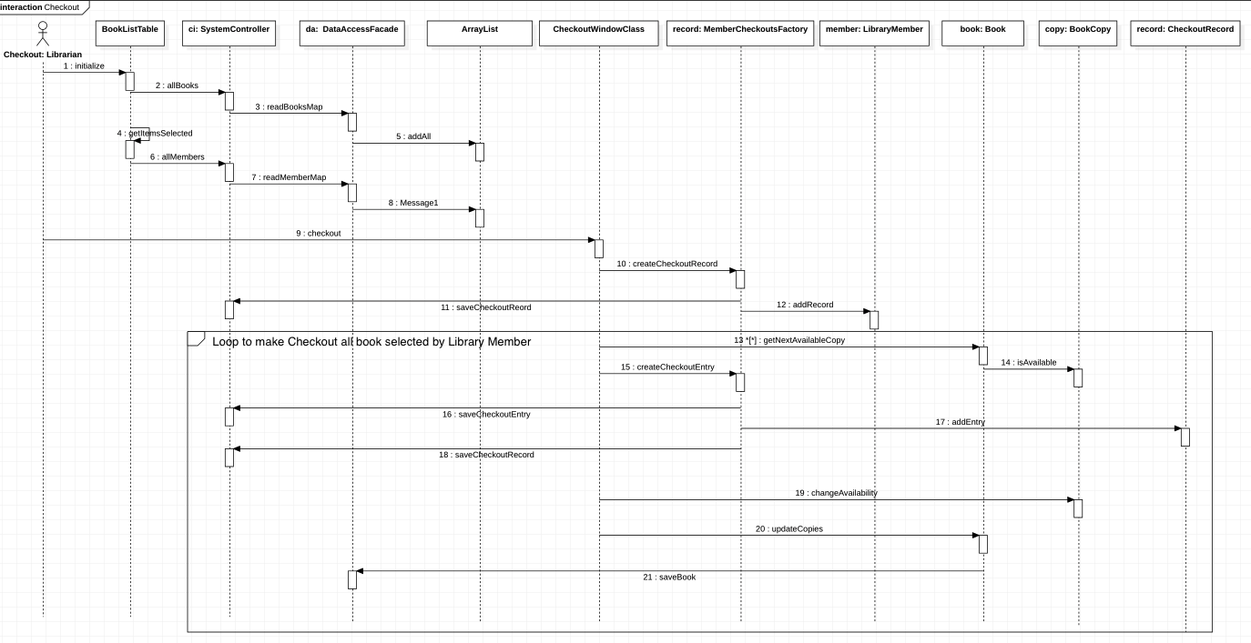
Checkout, Sequence Diagram

Slide 11
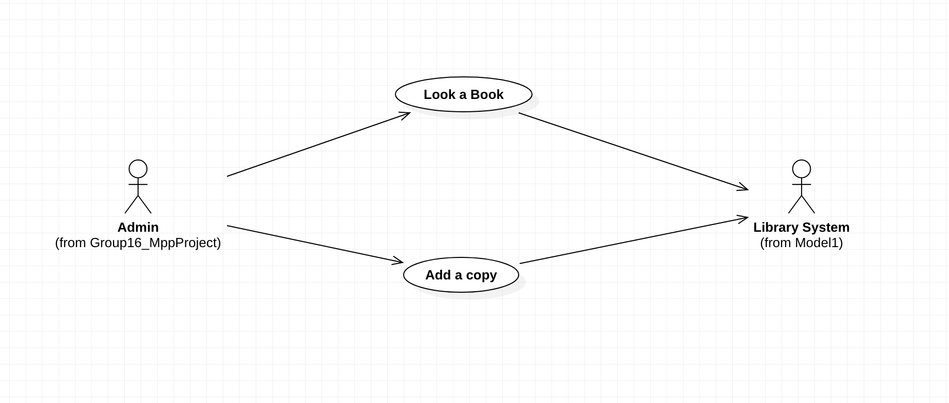
Add a Copy, Use case

Slide 12
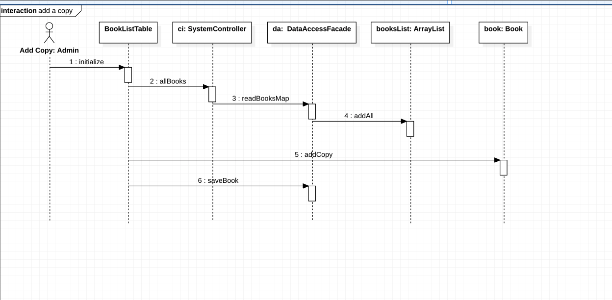
Add a Copy, Sequence Diagram

Slide 13
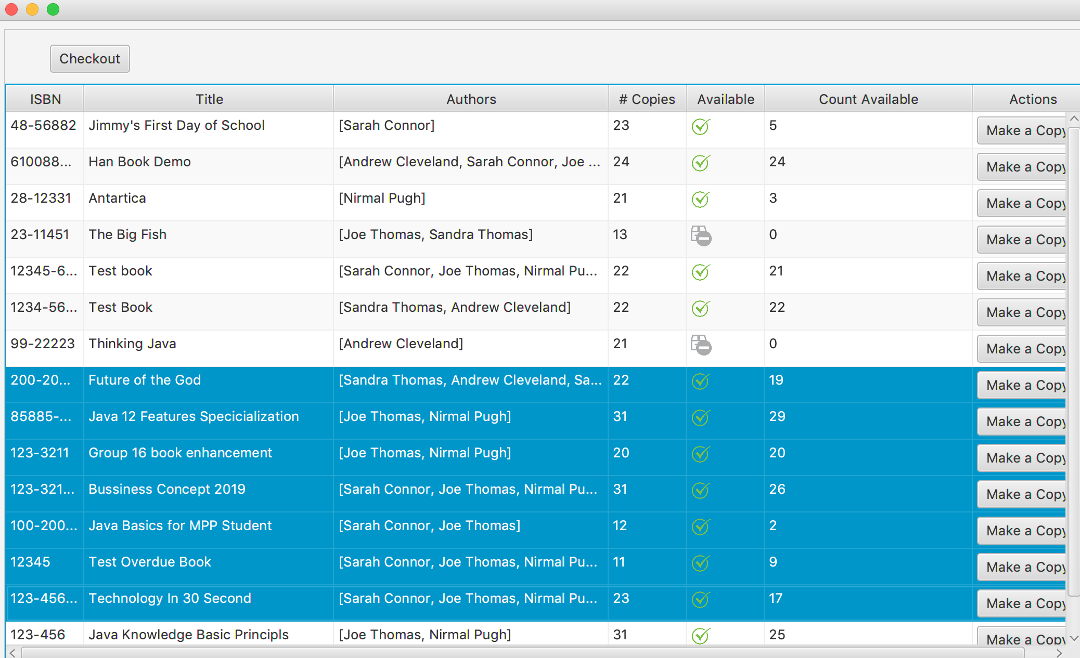
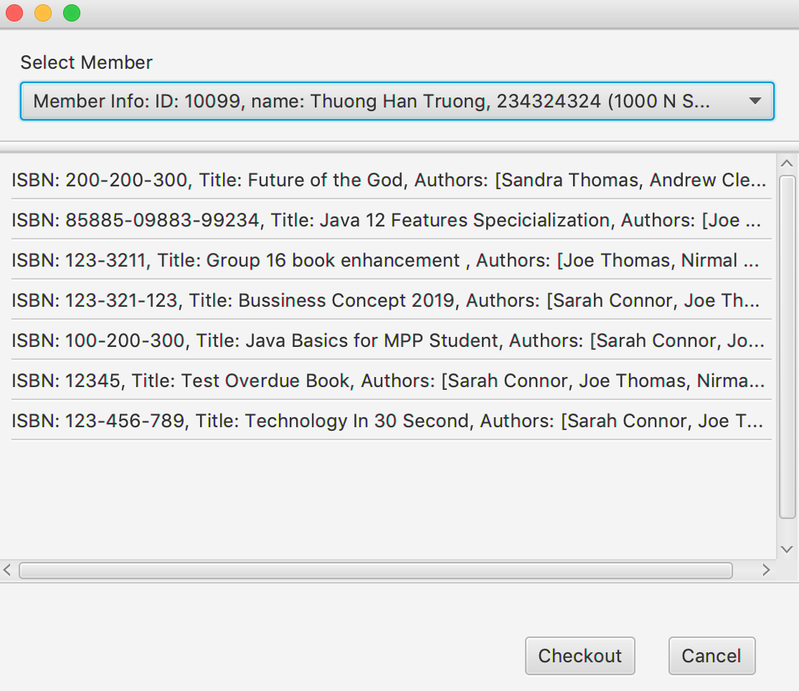
Checkout, Make a copy and more

Slide 14
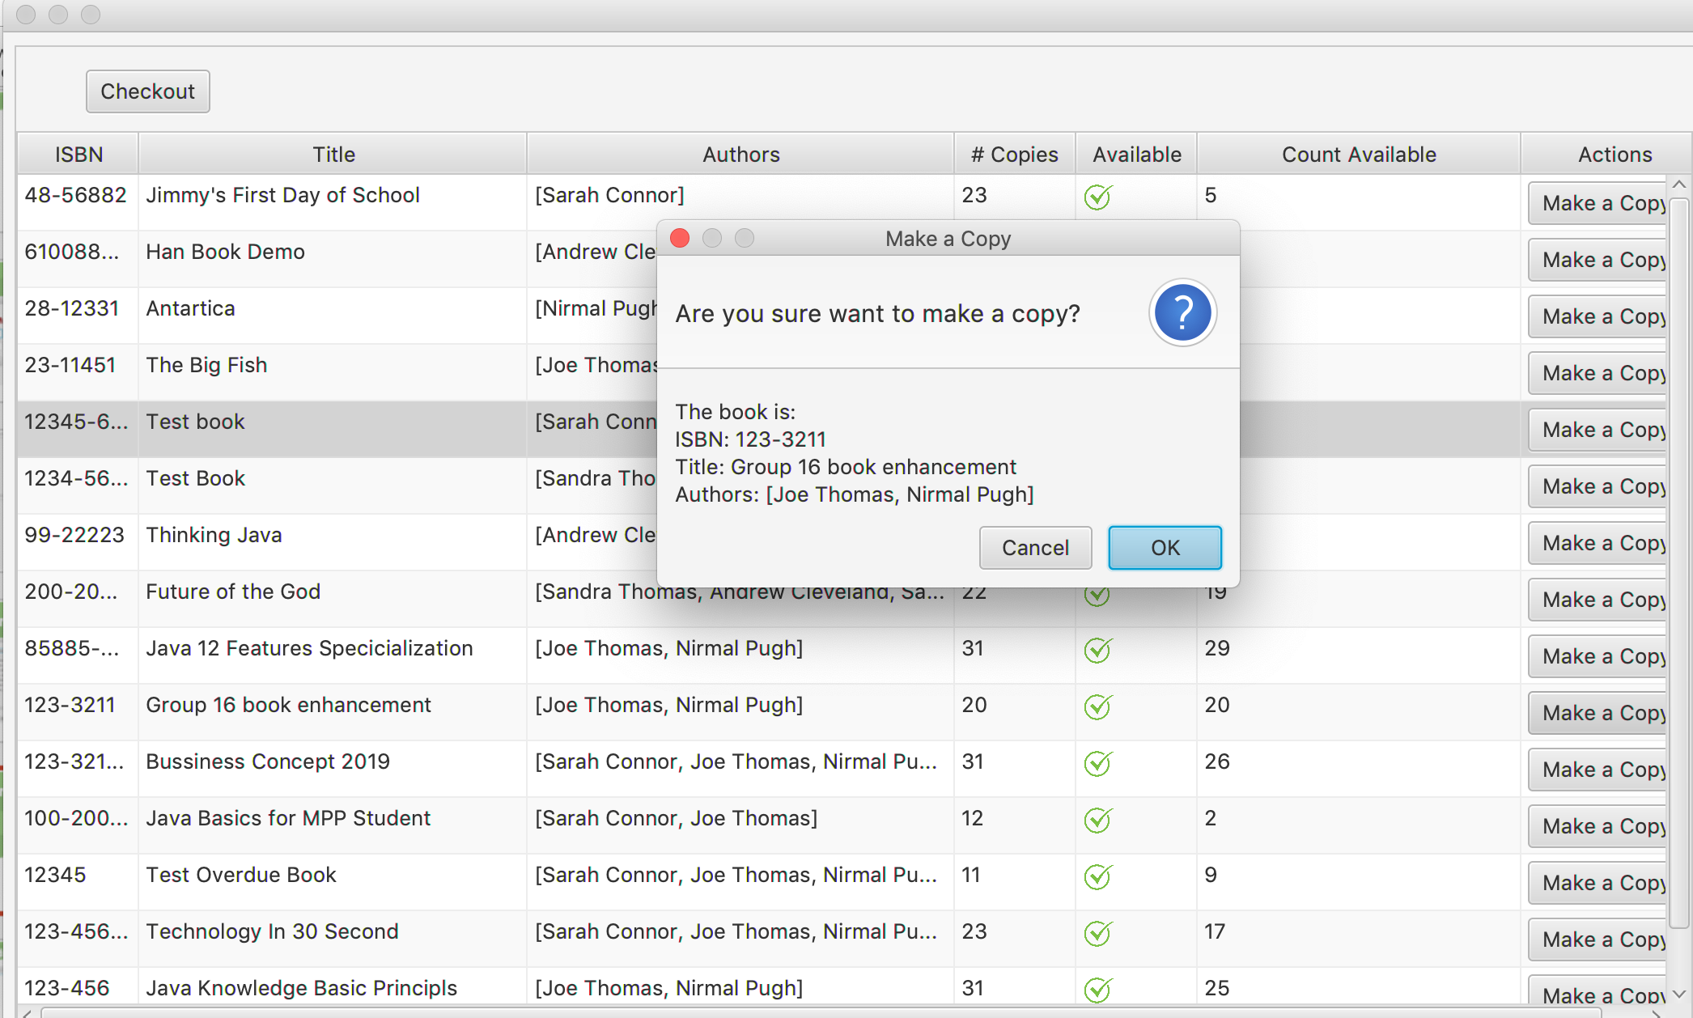
Checkout, Make a copy and more

Slide 15
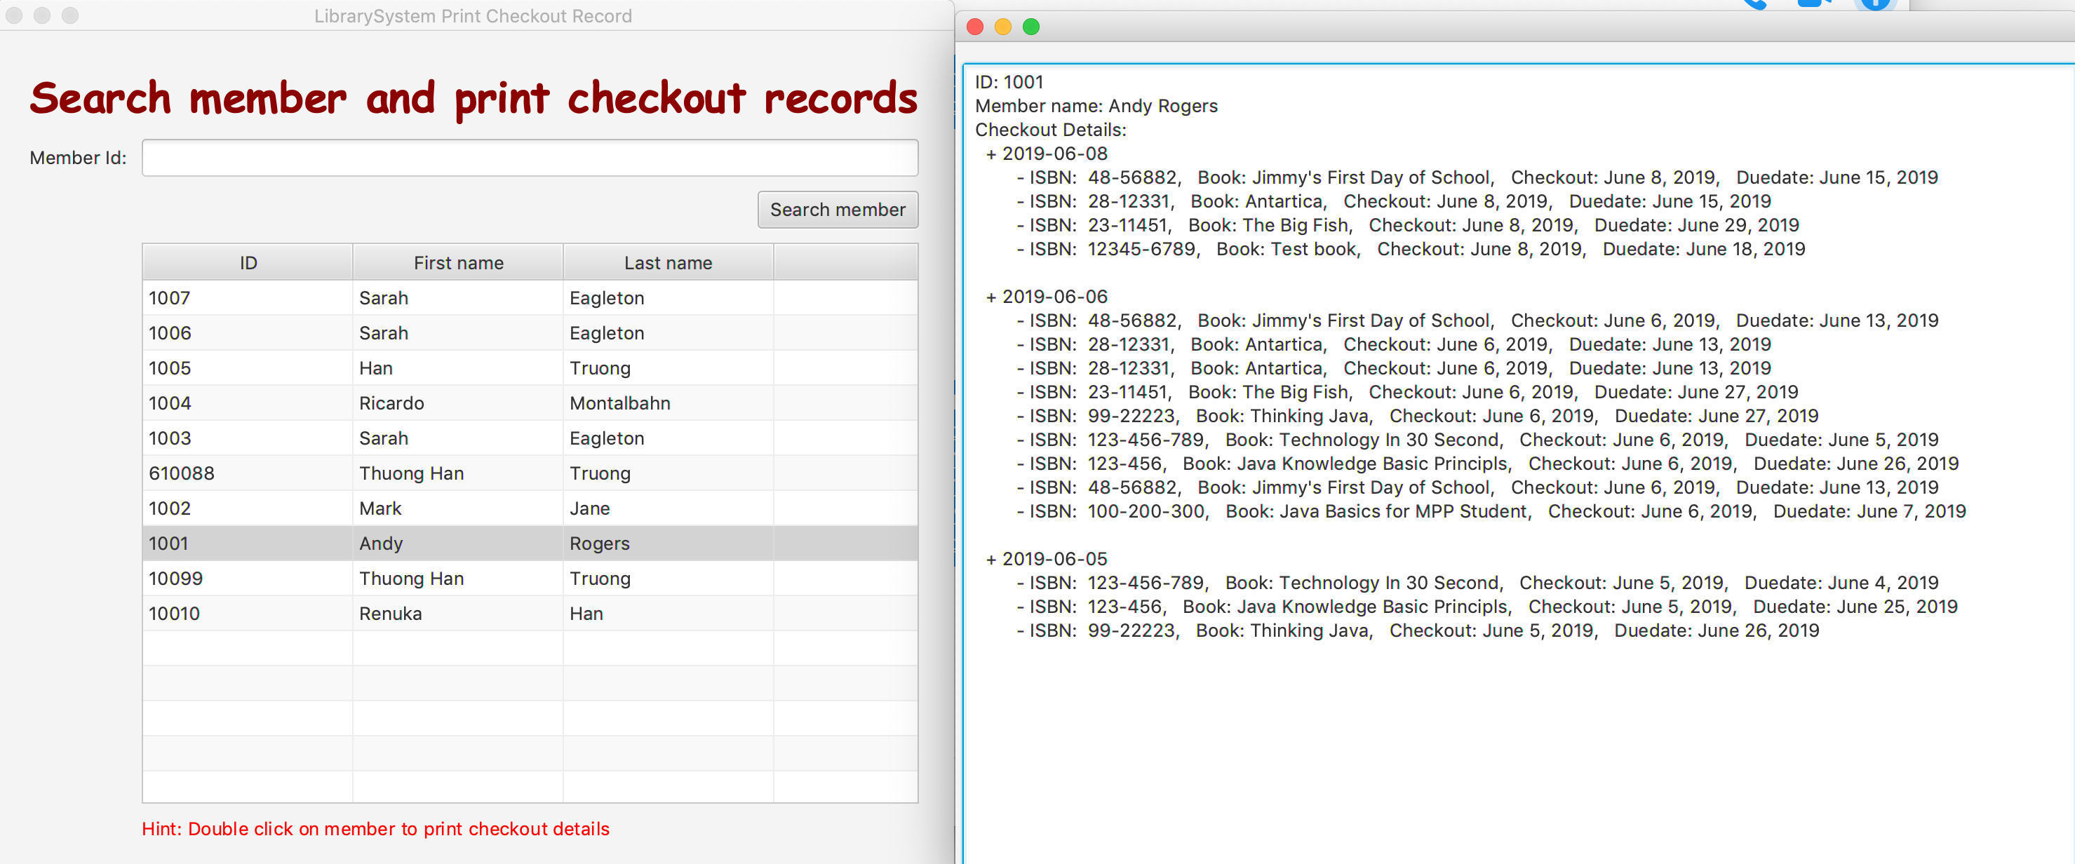
Search member and print checkout records

Slide 16
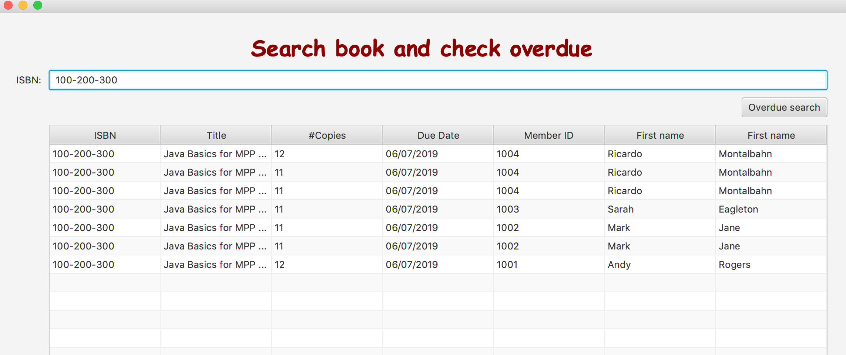
Search member for overdue

Slide 17
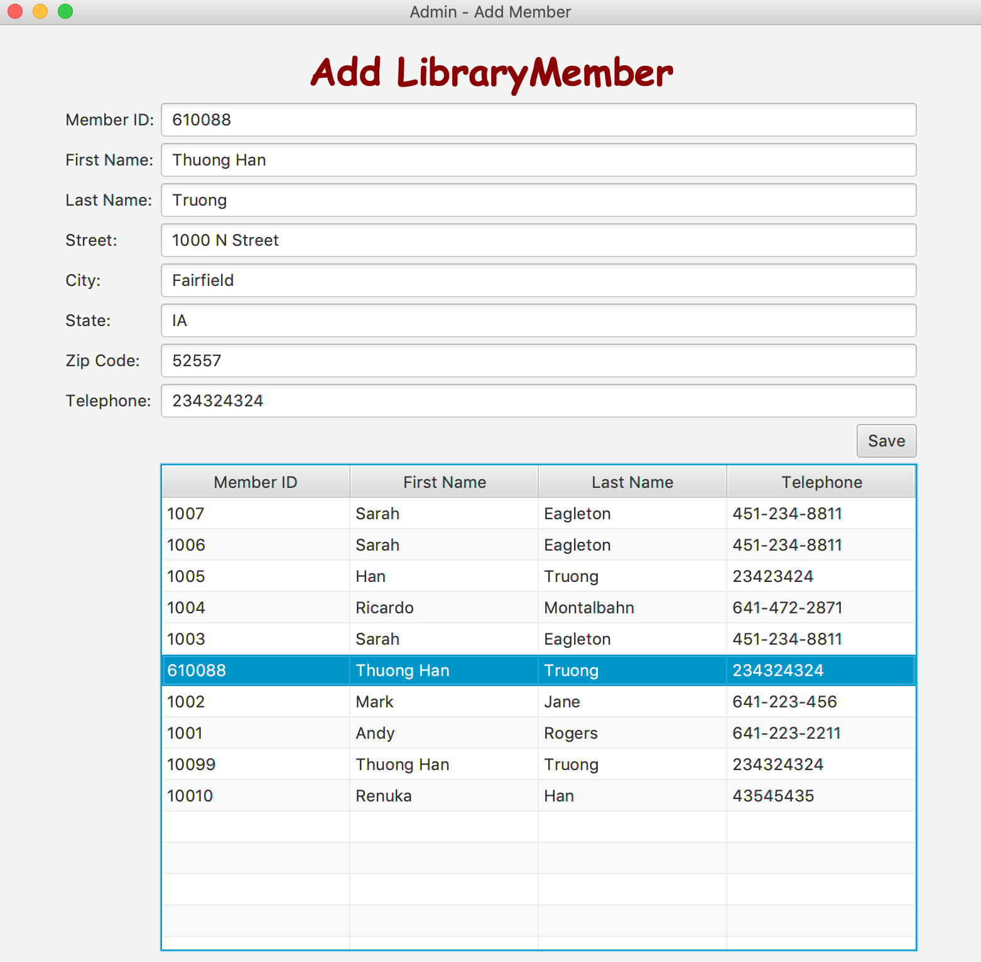
Add library member

Slide 18
Add library member
Use Case Description:
User Action | System Response
1. Authorization level of user as Administrator or both fills the form with fields: member id, first name, last name, street, city, state, zip, telephone number. Then submit to save the data. | 1. System checks validity of member id, zip, telephone number as number, first name, last name, and address as not empty. After validation the system checks existing of the member id, if the member ID is existed the data will be overridden. Otherwise, the data will be added as new member.

Slide 19
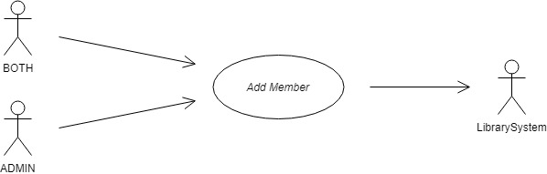
Add library member
Use Case:

Slide 20
Add library member
Sequence diagram:

Slide 21
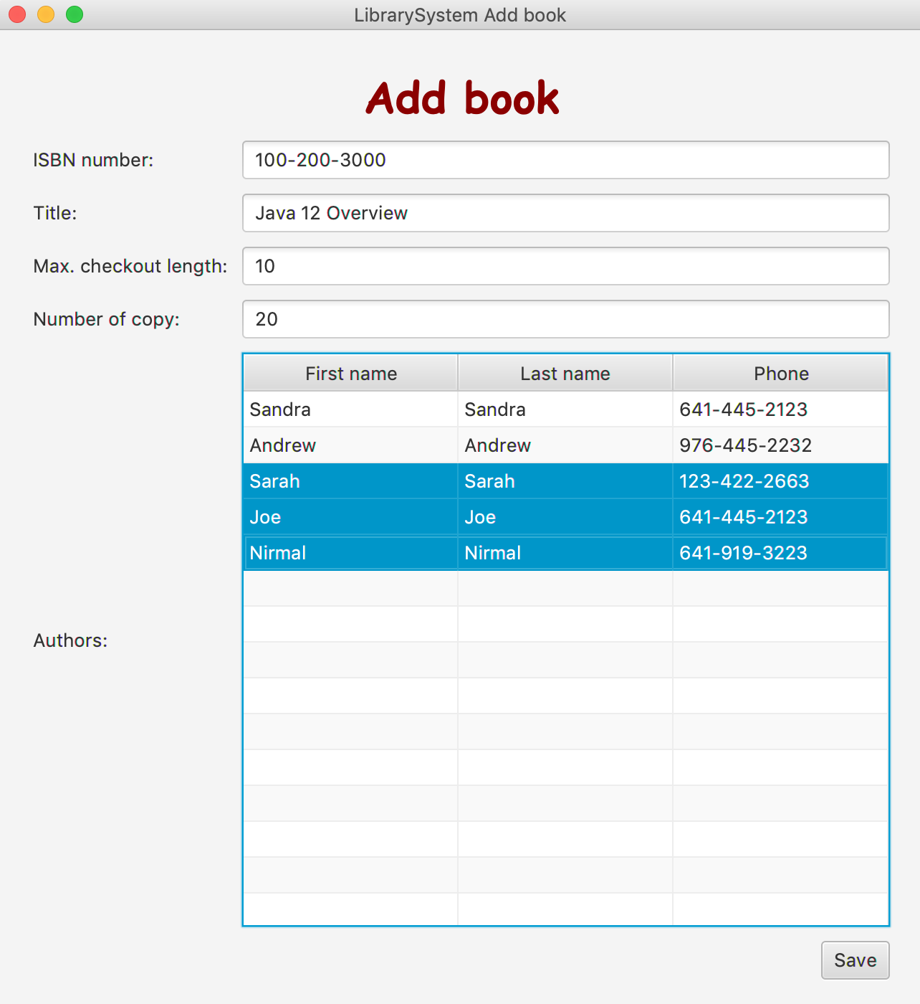
Add book

Slide 22
SCI knowledge
Knowledge is structured in consciousness. Transcendental Consciousness is the simplest state of awareness and consciousness, where the mind goes beyond thoughts and concepts to the most abstract level of awareness – the "abstract content" of awareness.
The “simplest” association is the relationship of pure consciousness to itself; this can also be modeled with an arrow from pure consciousness to itself. The pure consciousness is the field of all possibilities, the source of all solutions.
Whole is contained in every part and wholeness moving within itself: In Unity Consciousness, one recognizes that the relationship of the Self to the Self is not only fundamental, but is in reality the only relationship there is.

